Slide 1


DEPARTMENT OF COMPUTER SCIENCE AND ENGINEERING
20CS8504 & PROJECT WORK
END SEMESTER PRACTICAL EXAMINATION- APRIL / MAY - 2026
Batch No.: 06
Date: 30-03-2026
Session: FN

Slide 2
A CROSS-MODAL ATTENTION FRAMEWORK FOR INTERPRETABLE AGE-RELATED MACULAR DEGENERATION GRADING USING FUNDUS AND OCT IMAGE FUSION
Guide Name:
Mrs.R.Jasmine M.E.,
AP/CSE
Team Members:
Kalaiyarasi M – 811722104067
Kaviya N – 811722104073
Monisha V – 811722104093
Nishanthi V – 811722104103

Slide 3
OBJECTIVE OF THE PROJECT
To develop an automated deep learning system for detecting and grading AMD using fundus and OCT images.
To improve accuracy by using deep learning models such as ResNet50 and DenseNet121 for better feature extraction.
To provide fast and reliable results with confidence score to assist doctors in early diagnosis and decision-making.

Slide 4
INTRODUCTION
Age-Related Macular Degeneration (AMD) is a serious eye disease that can cause vision loss in older people.
It affects the macula, which is responsible for clear central vision.
Fundus images show the surface of the retina, while OCT images show internal retinal layers.
Manual diagnosis is time-consuming and depends on doctor experience.
This project uses deep learning models like ResNet50 and DenseNet121 to automatically detect and classify AMD.

Slide 5
LITERATURE SURVEY
TITLE OF PAPER | AUTHOR(S) | PAPER GIST | TECHNOLOGY USED
A Concentrated Machine Learning-Based Classification System for AMD Diagnosis Using Fundus Images(2024) | Abd El-Khalek A. et al. | This paper uses machine learning to detect AMD from fundus images. It improves accuracy by extracting important retinal features. | Machine Learning (Feature-Based Classification)
Enhancing AMD Detection Using OCT Imaging: An AI Approach (2024) | Alenezi A. et al. | This study uses AI with OCT images to detect AMD. It helps identify structural changes in the retina more clearly. | Deep Learning with OCT Image Analysis
Cross-Modal Attention Network for Retinal Disease Classification (2024) | Liu Z. et al. | This paper proposes a cross-modal attention model to combine different image types. It improves classification by focusing on important features. | Cross-Modal Attention Network
Multimodal Deep Learning for Automated AMD Classification Using Fundus and OCT Images (2024) | Li Zhang et al. | This study uses AI with OCT images to detect AMD. It helps identify structural changes in the retina more clearly. | Multimodal Deep Learning (Feature Fusion)

Slide 6
TITLE OF PAPER | AUTHOR(S) | PAPER GIST | TECHNOLOGY USED
Deep Learning-Based AMD Detection Using Fundus Images (2024) | S. Kumar, R. Patel, V. Singh | This paper uses fundus images to detect AMD using deep learning. It focuses on identifying features like drusen and pigmentation changes. | Convolutional Neural Networks (CNN) on Fundus Images
Multi-Modal and Multi-View Fundus Image Fusion for Retinopathy Diagnosis (2025) | Huang Y. et al. | This research combines multiple fundus images using attention methods. It improves diagnosis by capturing more detailed retinal information. | Multi-Scale Cross-Attention & Transformer-Based Model
Lesion Detection in AMD Using Multi-Modal Imaging and Machine Learning (2025) | Yap C. et al. | This paper uses machine learning to detect AMD from fundus images. It improves accuracy by extracting important retinal features. | Machine Learning with Multimodal Imaging
Automated AMD Classification Using OCT Images (2025) | A. Mehta, K. Joshi, P. Nair | This paper uses OCT images to classify AMD by analyzing retinal layer structures. It helps detect structural abnormalities in early stages. | Deep Learning (CNN) on OCT Images

Slide 7
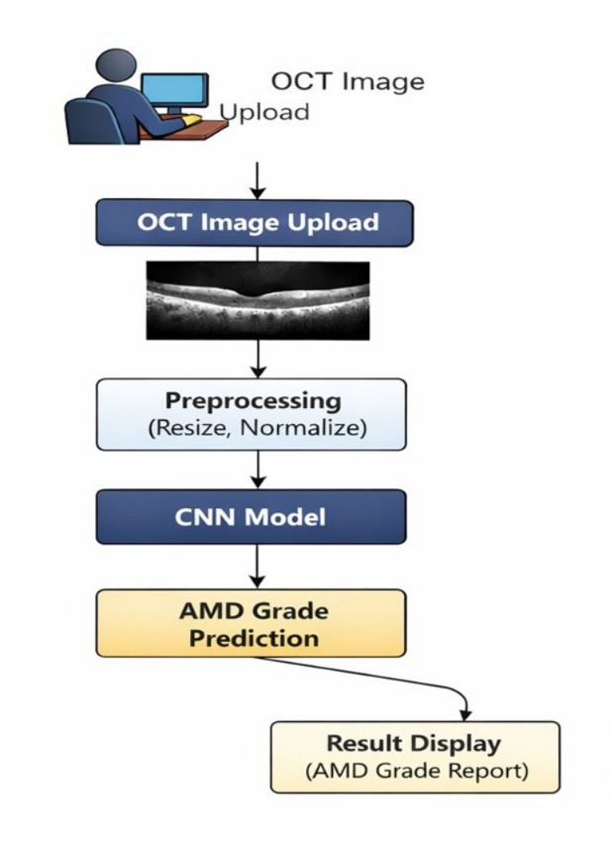
EXISTING SYSTEM ARCHITECTURE

Slide 8
PROBLEM IDENTIFIED
The system uses only OCT images, so it misses important details from fundus images.
It does not combine different image types, so accuracy is lower.
The prediction is less accurate compared to the proposed system.
The system cannot clearly identify different stages of AMD.
It does not provide detailed analysis, so doctors may not fully trust the result.

Slide 9
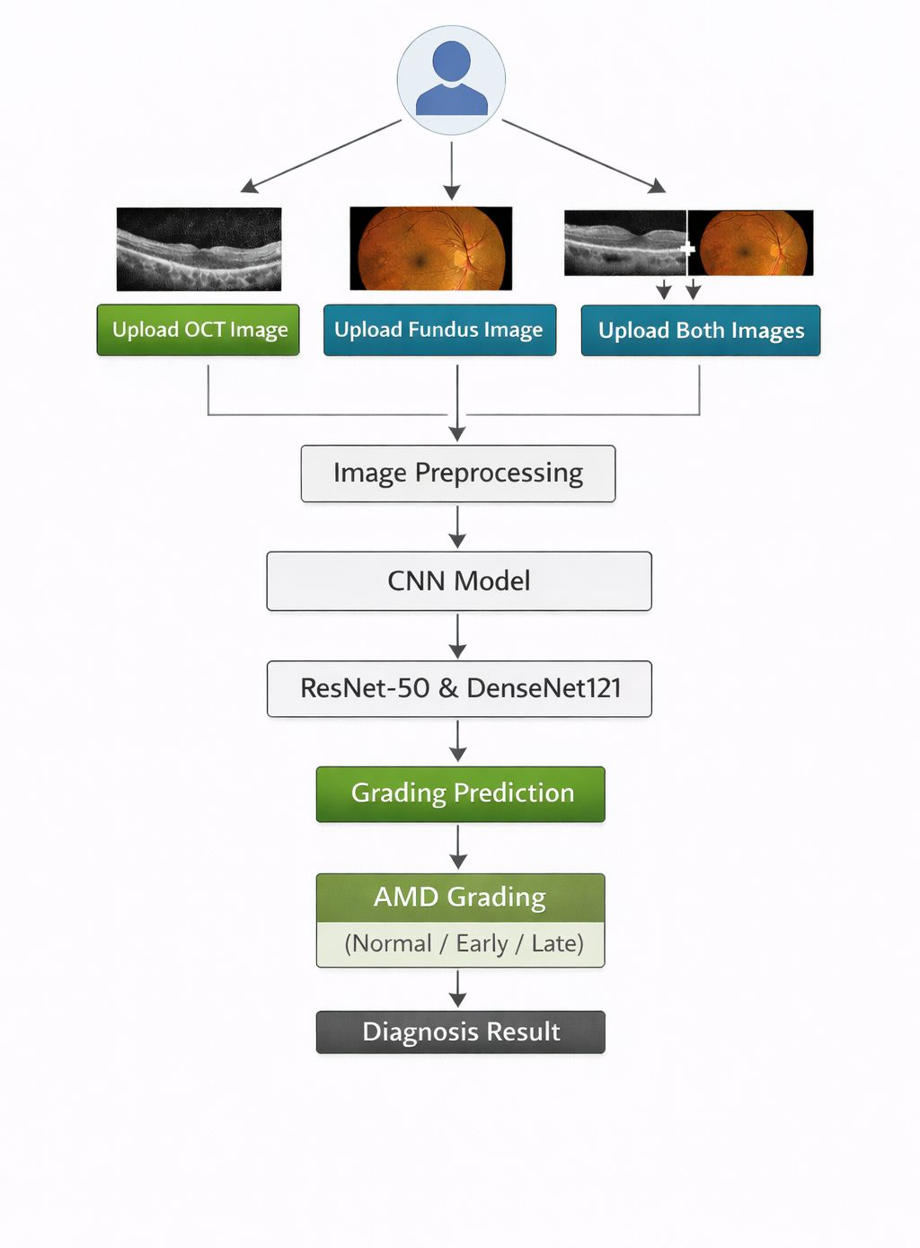
PROPOSED SYSTEM ARCHITECTURE

Slide 10
SOFTWARE AND HARDWARE REQUIREMENTS
HARDWARE
Processor : Intel processor 2.6.0GHZ
RAM : 8 GB
Hard disk : 256 GB
Compact Disk : 650 Mb
SOFTWARE
Server Side : Python 3.11(64-bit)
Client Side : HTML, CSS, Bootstrap
Back end : SQLite
OS : Windows 11 64 –bit

Slide 11
MODULES
IMAGE ACQUISITION MODULE
IMAGE PREPROCESSING MODULE
MODEL CONSTRUCTION MODULE
CLASSIFICATION MODULE
DISEASE DIAGNOSIS MODULE

Slide 12
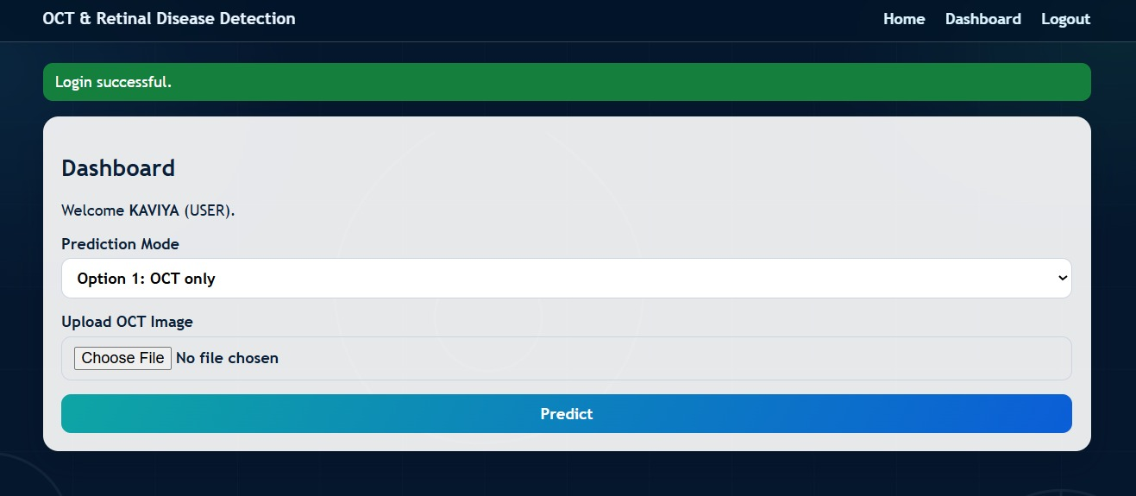
IMAGE ACQUISITION MODULE
Collects fundus and OCT images from the user through upload.
Supports single image or both images for better analysis.

Slide 13
IMAGE PREPROCESSING MODULE
Images are resized and normalized to maintain uniform size.
Improves image quality using basic enhancement techniques.

Slide 14
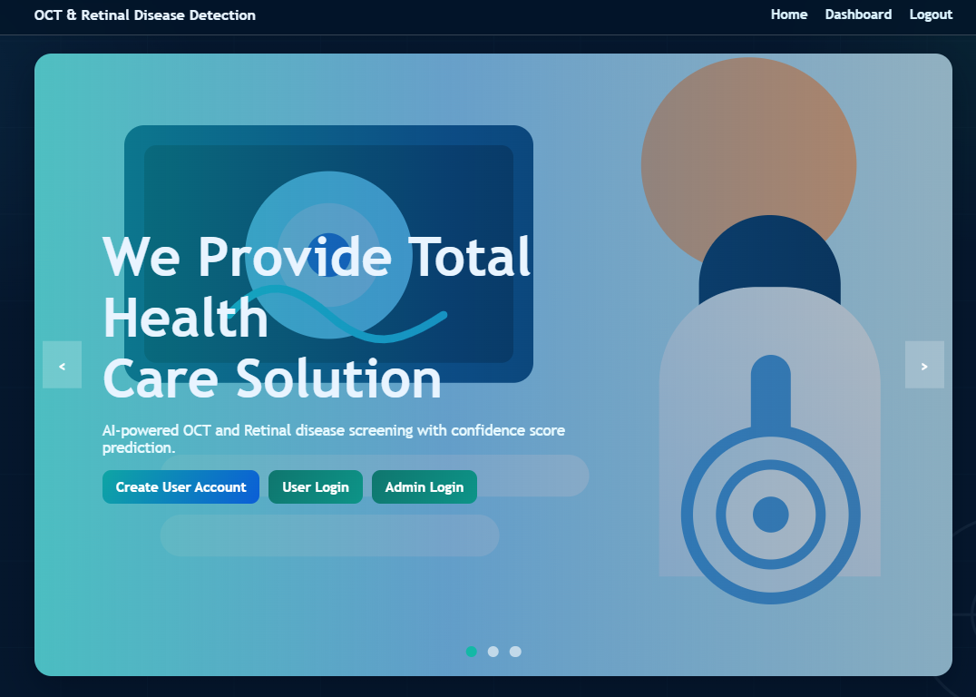
MODEL CONSTRUCTION MODULE
Uses ResNet50 and DenseNet121 for feature extraction.
Learns important patterns from fundus and OCT images.

Slide 15
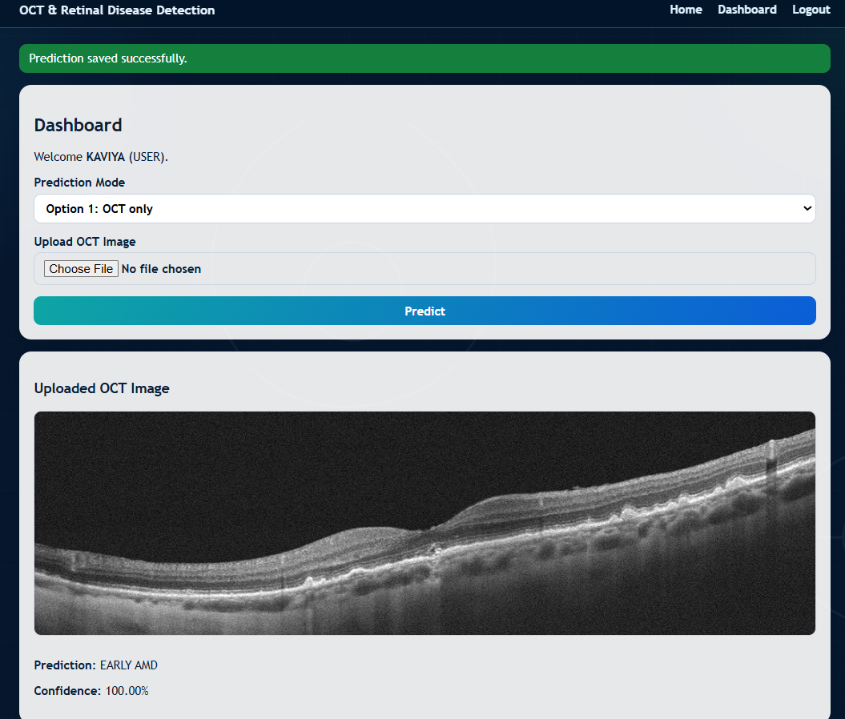
CLASSIFICATION MODULE
The extracted features such as texture (drusen), structural patterns (retinal layers), and spatial features are used to classify AMD stages.
Softmax function changes the model output into percentage values so the system can easily choose the final result.

Slide 16
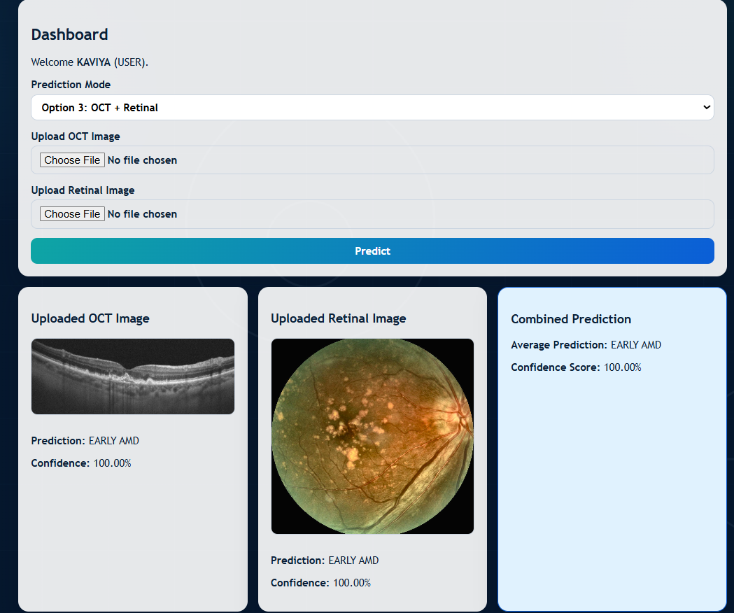
DISEASE DIAGNOSIS MODULE
Final prediction and confidence score are displayed to the user.
Results are stored for future reference and analysis.

Slide 17
CONCLUSION
The system successfully detects and classifies AMD using deep learning models like ResNet50 and DenseNet121.
It helps doctors by providing fast and reliable results for early diagnosis and treatment.

Slide 18
FUTURE ENHANCEMENTS
Develop a real-time cloud-based system for remote diagnosis and storage.
Integrate Grad-CAM or Explainable AI (XAI) to highlight important retinal regions.
Extend the system to detect multiple eye diseases like Diabetic Retinopathy and Glaucoma.

